Slide 1

Ruby on Rails

Slide 2
About today…
Ruby on Rails
Validate Form Input
Implement Error Handling

Slide 3

Validate Input

Slide 4

Introduction to Validations
Key Points
Validations ensure data integrity
Rails provides built-in validation helpers

Slide 5
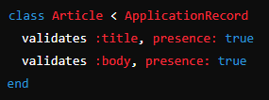
Adding Validations to the Model
Example

Slide 6




Common Validation Helpers
Presence
Length
Uniqueness

Slide 8
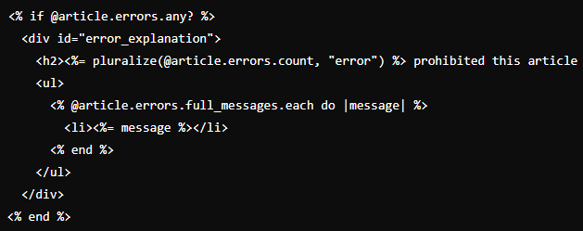
Displaying Validation Errors in the View
Showing Errors

Slide 9
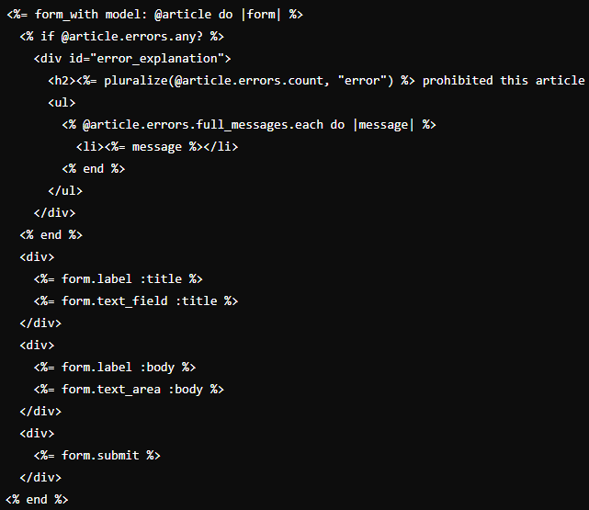
Example

Slide 10
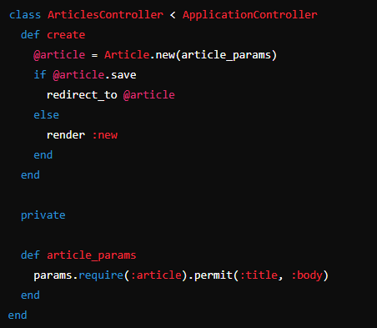
Validations in Controller
Checking Validations

Slide 11


Slide 12

What is the primary purpose of validations in Rails applications?
Which Rails method is used to define validations for a model?
How can you validate the presence of a field in a Rails model?
What does the article_params method do in a Rails controller related to validations?

Slide 13

Task 1
Create a small form, add validation, skip a value, check what happens

